Slide 1

Identification and Detection of Non-Object Areas for Data Hiding in Images using YOLOv8
Advanced Steganography through Deep Learning Object Detection
This work focuses on identifying and isolating non-object regions within images using the YOLOv8 deep learning framework. These detected non-object areas are then utilized as secure and imperceptible zones for efficient data hiding.
2310080022-J. Akhil Sai Reddy 2310080007- M SHOAIB HANNAN

Slide 2

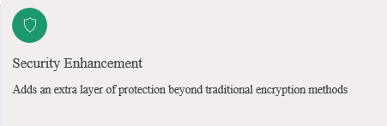
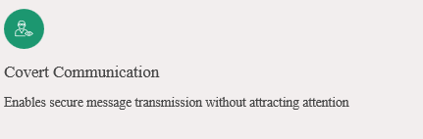




The Art of Invisible Communication
What is Steganography?
Steganography is the practice of concealing secret information within ordinary digital media. Unlike encryption, which scrambles data, steganography hides the very existence of the message itself.
The goal: embed sensitive data invisibly within images, maintaining visual integrity while securing confidential communications.

Slide 3





Why Non-Object Areas Matter
Non-object areas are the background regions of an image where no significant objects are detected. These regions are ideal for data embedding because modifications are less noticeable to human perception.
Object Detection First
Identify and locate all important objects in the image using advanced detection algorithms
Masking Objects
Create protective masks around detected objects to avoid altering critical visual elements
Safe Embedding Zones
Utilize remaining background areas for secure data hiding with minimal perceptual impact
Key Advantage: Embedding data in non-object areas preserves image quality and reduces detection risk, as human attention naturally focuses on foreground objects rather than backgrounds.

Slide 4
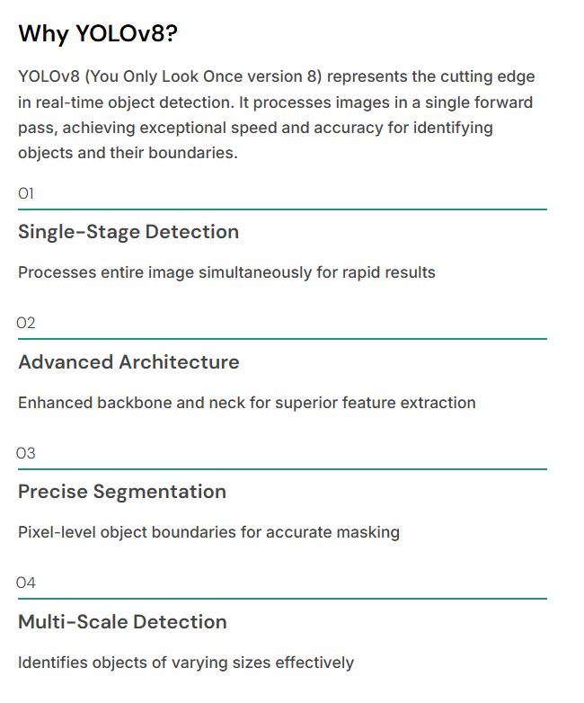
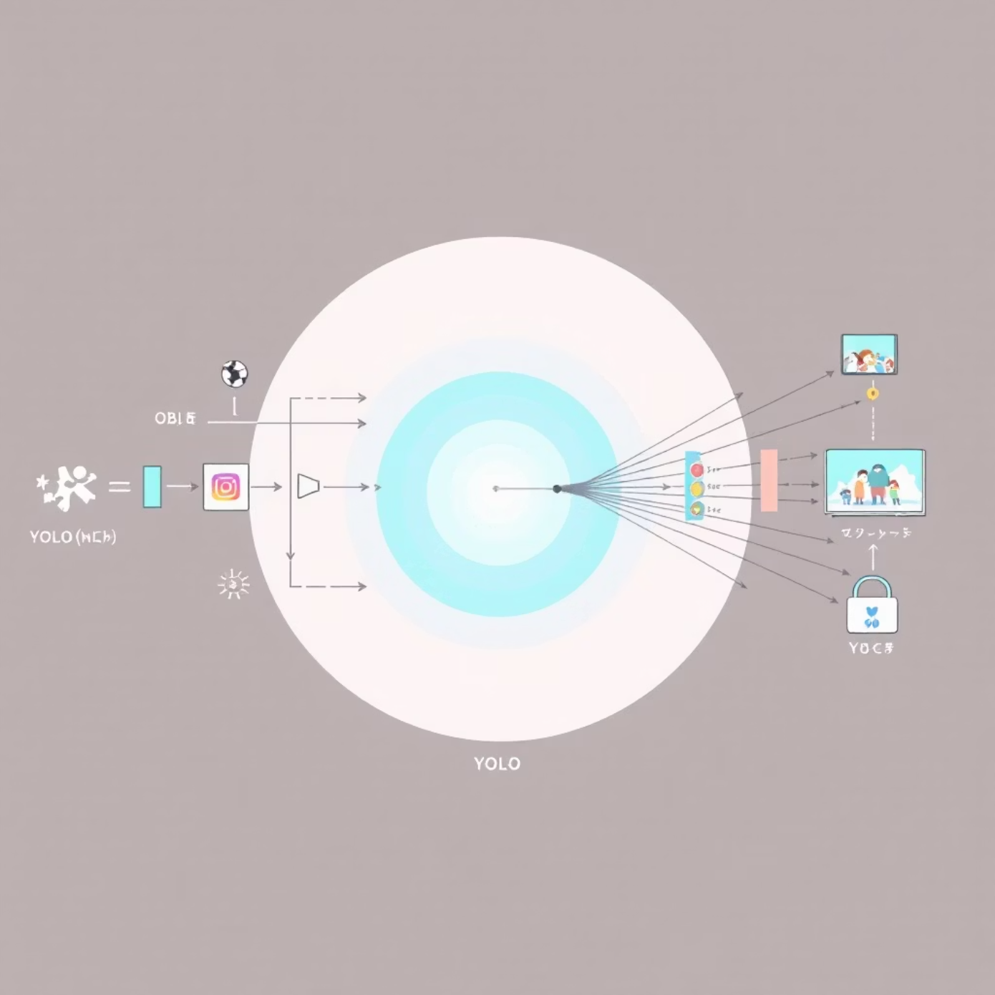
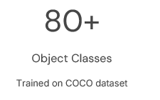

YOLOv8: The Detection Powerhouse
50ms
Processing Time
Real-time performance

Slide 5


Proposed Methodology
Our system integrates state-of-the-art object detection with intelligent steganography to create a secure, imperceptible data hiding framework.
Image Input
Load and preprocess the cover image for analysis
YOLOv8 Detection
Run object detection to identify all significant objects and their precise boundaries
Object Masking
Generate binary masks that protect detected object regions from modification
Non-Object Identification
Isolate background areas by inverting object masks to find safe embedding zones
Data Embedding
Apply steganographic algorithm exclusively within non-object regions
Output Generation
Produce stego-image with hidden data, maintaining visual quality

Slide 6
System Workflow Architecture
Input Layer
Detection Module
Segmentation
Cover image + Secret data
YOLOv8 object recognition
Mask generation & inversion
Embedding Engine
Output Layer
Steganography algorithm
Stego-image generation
Detection Phase
Embedding Phase
Image preprocessing and normalization
Non-object pixel identification
YOLOv8 inference for object localization
Data encryption and preparation
Bounding box and segmentation mask extraction
LSB/DCT/DWT embedding in safe zones
Confidence threshold filtering
Quality assessment and validation

Slide 7

Algorithms & Techniques
1
2
3
YOLOv8 Object Detection
Segmentation & Masking
Steganography Methods
Employs convolutional neural networks with anchor-free detection heads. The model processes images through CSPDarknet53 backbone, extracting multi-scale features for accurate object localization and classification.
Binary mask generation creates protective layers over detected objects. Morphological operations refine mask boundaries, while inversion reveals embedding-safe background regions.
Multiple embedding techniques ensure flexibility and security:
LSB (Least Significant Bit): Modifies least significant bits in non-object pixels
DCT (Discrete Cosine Transform): Embeds data in frequency domain for robustness
Real-time inference with GPU acceleration
Dilation and erosion for mask refinement
Instance segmentation for pixel-perfect masks
Connected component analysis
DWT (Discrete Wavelet Transform): Multi-resolution embedding in wavelet coefficients

Slide 8

Dataset & Training Configuration
Dataset
The dataset consists of diverse indoor and outdoor images to ensure robust detection across multiple environments.
All images are annotated in YOLO format, marking the object regions precisely.
Preprocessing includes resizing, normalization, and augmentation (flip, scale, brightness adjustments) to improve generalization.
The dataset helps the model learn the distinction between object areas and non-object/background areas effectively.
Training Configuration
YOLOv8 is trained using optimized hyperparameters (learning rate, batch size, momentum, weight decay).
Data augmentation settings follow Ultralytics YOLOv8 recommendations for improved performance.
Training is performed for multiple epochs until accurate convergence is achieved.
A validation set is used to monitor performance and prevent overfitting.
The final trained model is optimized for detecting non-object regions suitable for data hiding applications.

Slide 9












Results & Real-World Applications
Performance Metrics
85%
99%
98%
Embedding Capacity
Data Integrity
Visual Quality
Successfully utilized non-object pixel regions
Accurate extraction without corruption
PSNR above 45dB maintains imperceptibility
Practical Applications
Secure Communication
Digital Watermarking
Covert channels for sensitive information transmission
Copyright protection and ownership verification for digital media
Defense & Intelligence
Medical Data Privacy
Embedding patient information within diagnostic images
Classified information transfer through innocuous images

Slide 10


Conclusion & Future Directions
Key Advantages
Future Scope
Intelligent Detection
Adaptive Embedding
YOLOv8 ensures objects remain untouched, preserving image semantics
Dynamic capacity adjustment based on non-object area size and complexity
Enhanced Security
Background-only embedding reduces statistical detection vulnerability
Multi-Modal Detection
Extend to video streams and other media formats for broader applications
Scalability
Automated pipeline processes large image volumes efficiently
Robustness Enhancement
Develop resistance against compression, cropping, and adversarial attacks
Flexibility
Compatible with multiple steganographic algorithms
Deep Learning Integration
Neural network-based embedding for improved security and capacity
Project Impact: This research demonstrates how modern object detection can revolutionize steganography, creating intelligent systems that balance security, capacity, and imperceptibility for next-generation covert communication.

